Slide 1
DHL V³ Website Instruction Manual
Ray Hu
Solutions Design
08/2017

Slide 2
Place holder - if user needs to pre-set environment to view the website.

Slide 3


Navigation Panel
VIP, Vendor and Valet are the three aspects of the website.
This will lead you to the sign up page.
Log in as VIP, Vendor or Valet to acquire customized functions.
Home page of the website.

Slide 4
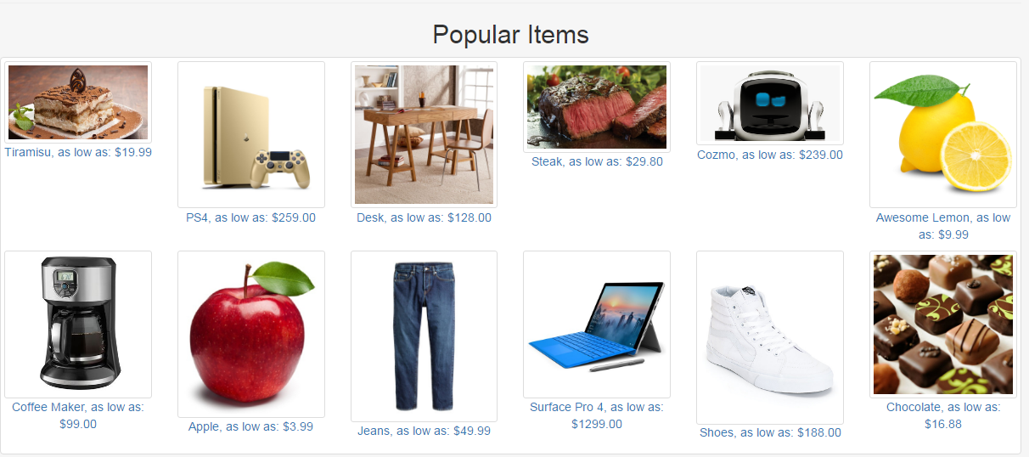
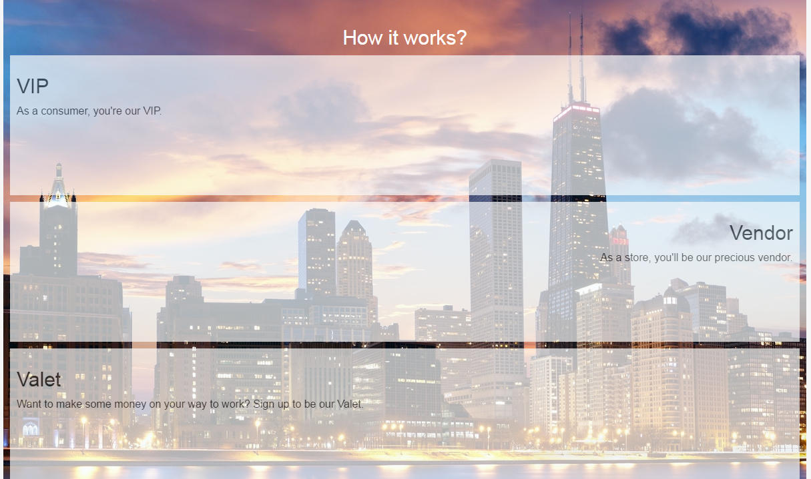
Home
Click “Home” on the navigation panel.
It explains how the website works and lists popular items.

Slide 5
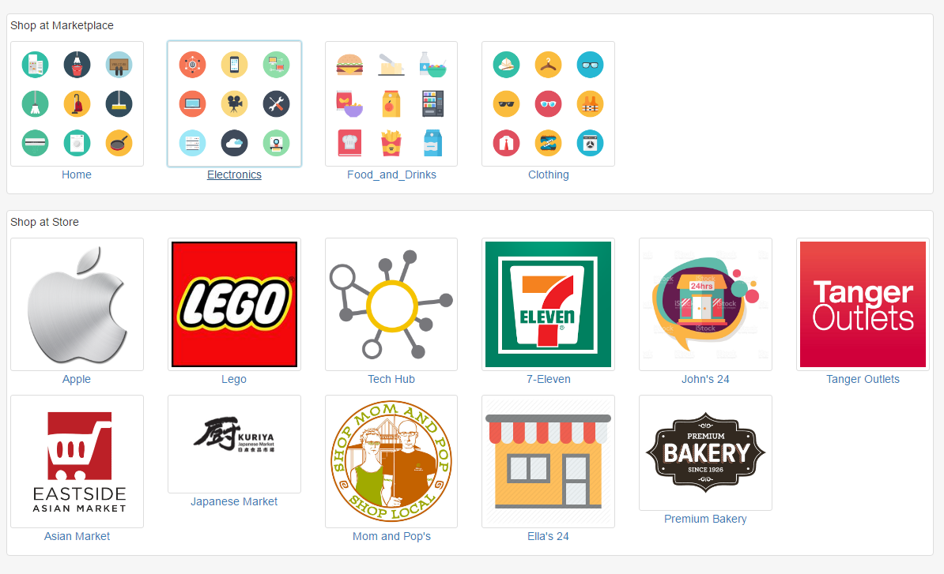
Log in as VIP
Click the top right “log in” on home page, choose User Type as VIP, type in 1 as Username and 1 as Password, click “Log In”.
After logging in, you can shop at marketplace or shop at store.

Slide 6
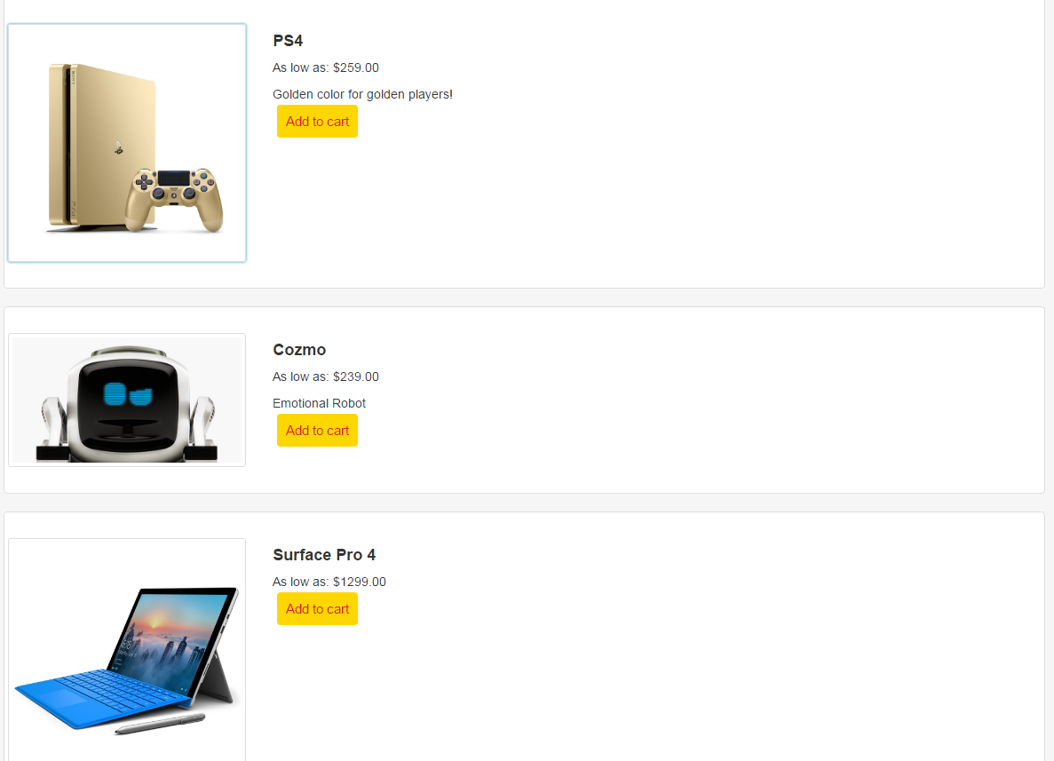
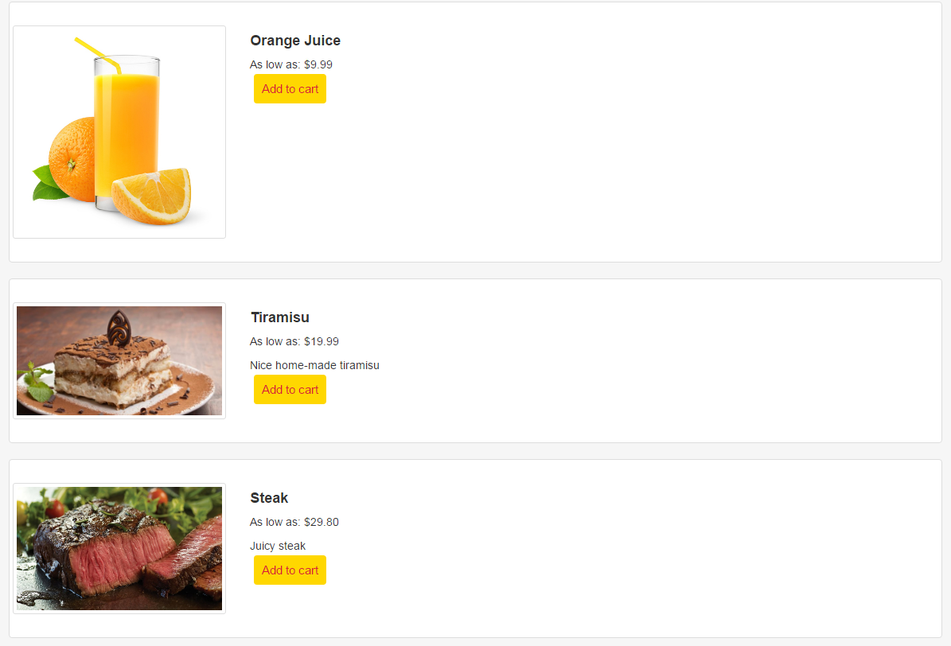
Shop at marketplace
Click any category, you can then see a list of items that belongs to the category. The “add into cart” button can add the item into shopping cart. Shopping cart right now is only for demo purpose, the “check out” button is a placeholder.
For example, “electronics” and “food and drinks” category sell the following.

Slide 7
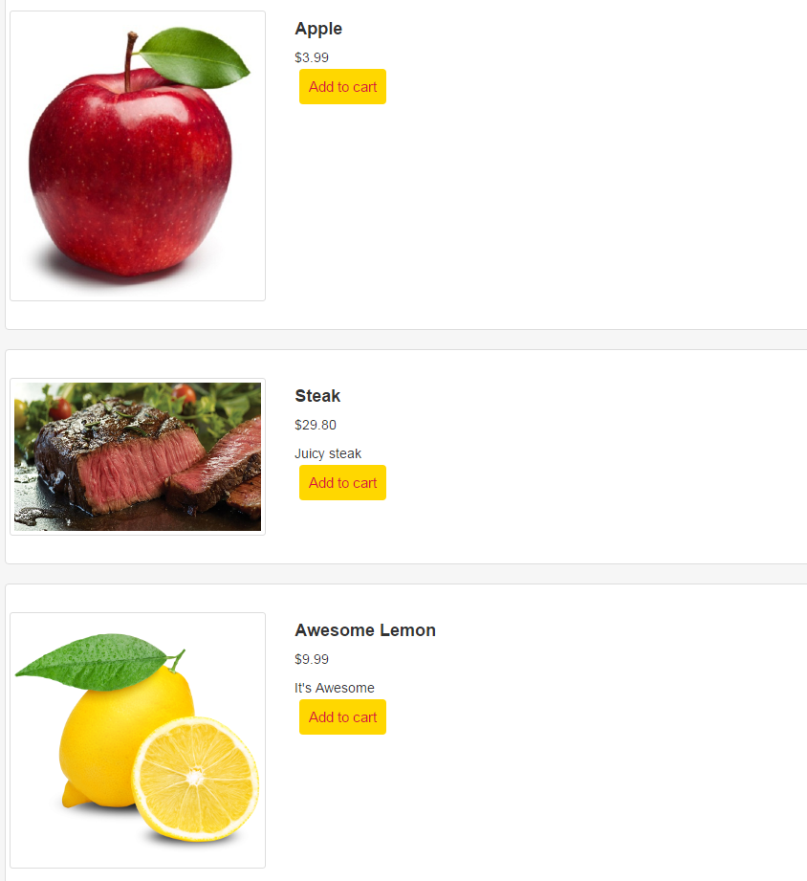
Shop at store
Click any store, you can then see a list of items that are being sold at this store.
The add into cart button can add the item into shopping cart.
For example, “Asian Market” sells the following:

Slide 8
Log in as Vendor
Click the top right “log in” on home page, choose User Type as Vendor, type in 1 as Username and 1 as Password, click “Log In”.
When logged in as a vendor, you’ll be able to see current inventory and orders from consumers.

Slide 9
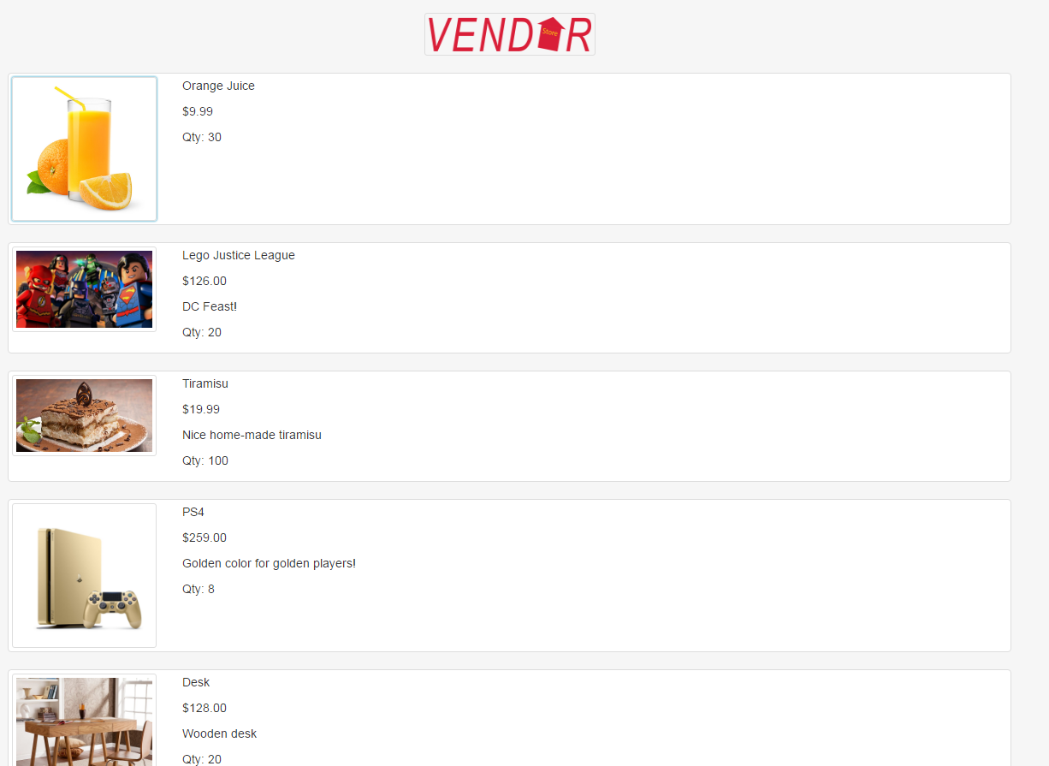
Show inventory
The “show inventory” button will show your current inventory.
Every item has name, price and quantity. (Other attributes can be added based on needs)

Slide 10
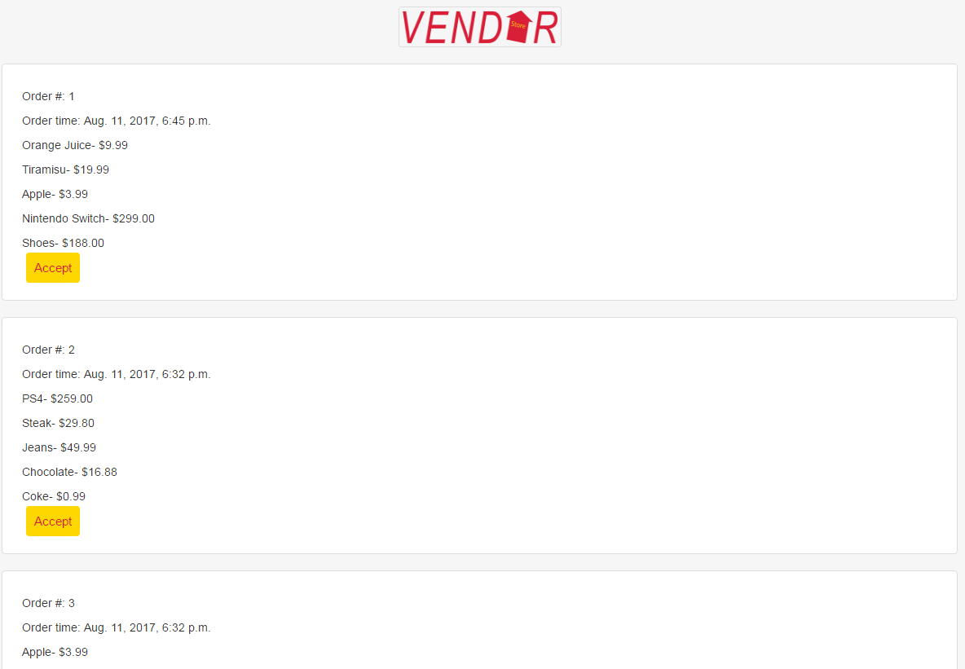
Show orders
The “show orders” button will show current orders from consumers.
A vendor can choose to accept orders based on their details.

Slide 11
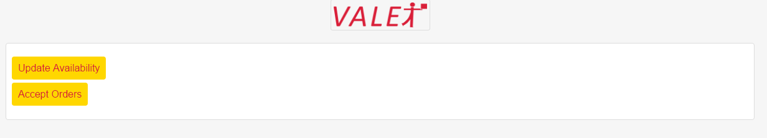
Log in as Valet
Click the top right “log in” on home page, choose User Type as Valet, type in 1 as Username and 1 as Password, click “Log In”.
A valet can update his/her availability for the next week and accept orders that are assigned, then deliver.

Slide 12
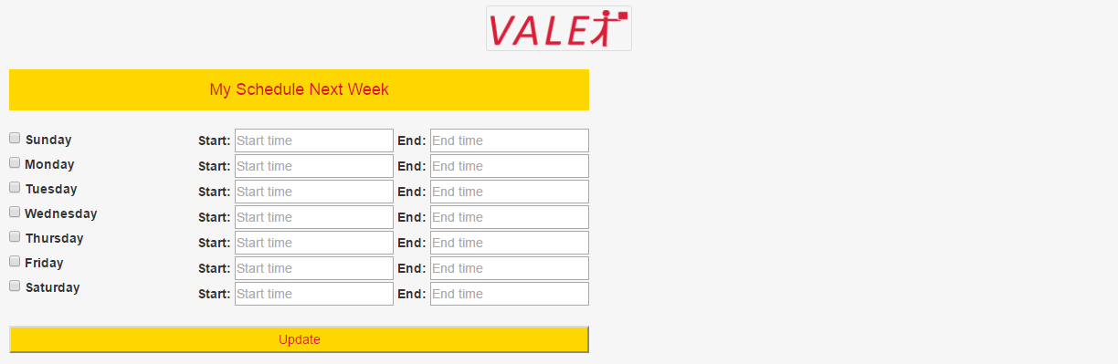
Update availability
The “update availability” button will lead a valet to update his/her schedule for the next week.
Our algorithm can assign valets based on their schedules.

Slide 13
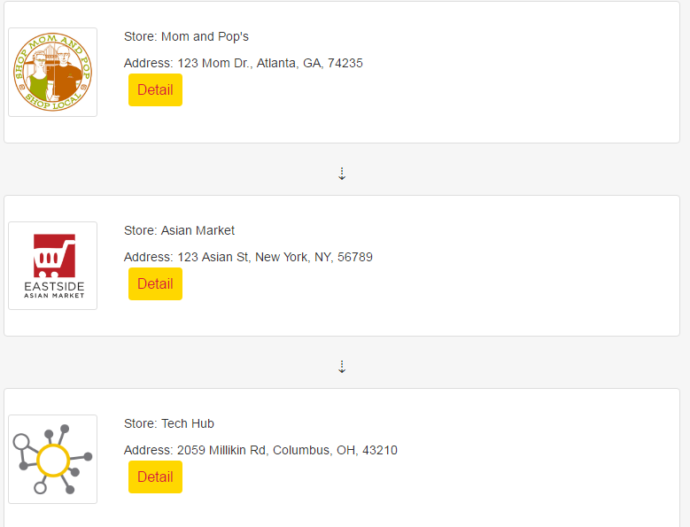
Accept Orders
The “accept orders” button will first show valets what stores they should visit (ordered according to our algorithm).

Slide 14
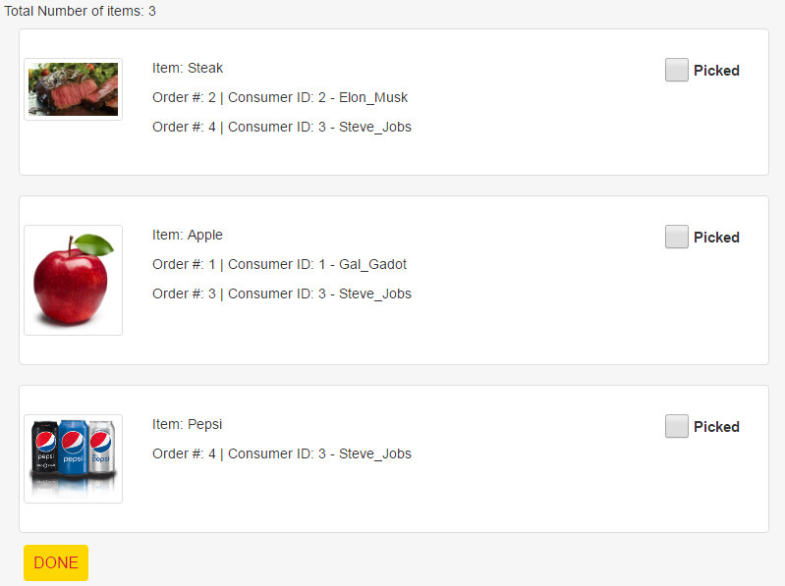
Accept Orders – Detail button
The “Detail” button of each store shows the items that a valet needs to pick-up, classified by order.
For example, if you click “Asian Market”, you’ll see the page below. A valet can pick-up items and allocate to each order. After picking, the valet can click “picked”, and at the end, the “Done” button will bring him/her back to the store sequence.

Slide 15
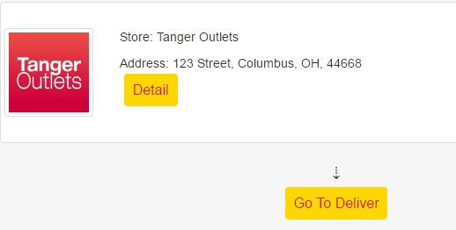
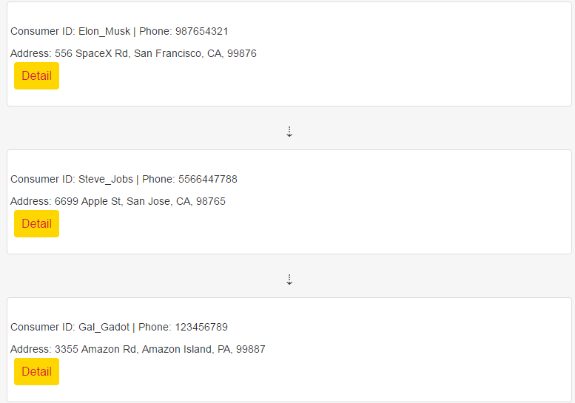
Deliver Orders
At the bottom of the store sequence, there’s a “Go to deliver” button, click it and go to the deliver page.
The deliver page shows the VIP list in the order that our valet needs to visit.

Slide 16
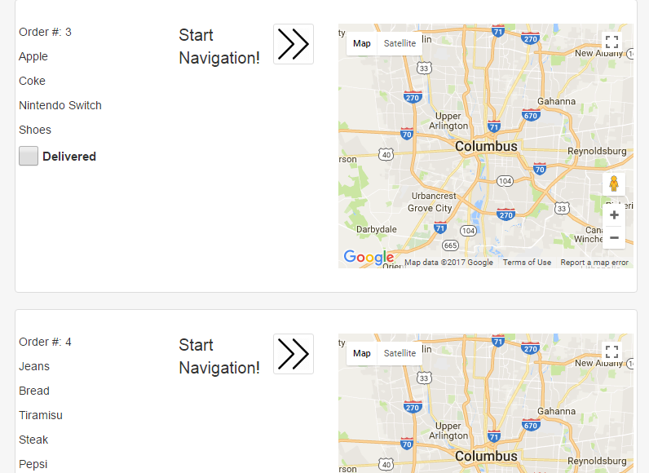
Deliver Orders – Detail Button
The “Detail” button of each VIP shows the orders and items that need to be delivered to each VIP. Sometimes a VIP may have multiple orders.
For example, let’s click the detail button of “Steve_Jobs”. We’ll see the two orders he places. After delivery, the valet can select “Delivered”. At the end, the “Done” button will bring him/her back to the VIP sequence. Notice that we have a google map to help navigate.

Slide 17
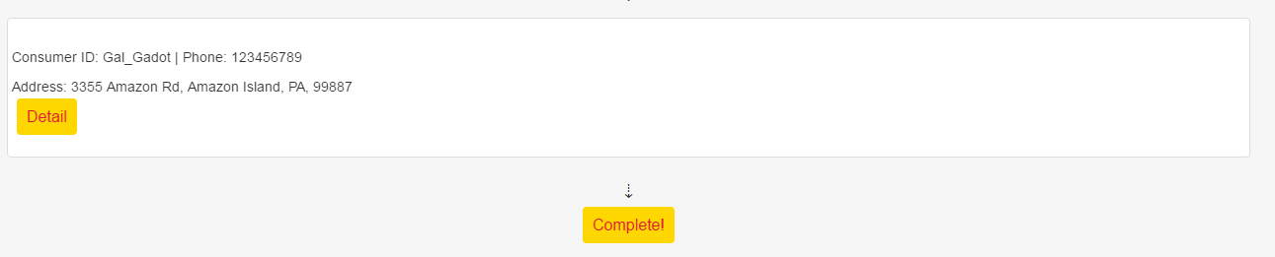
Deliver Orders - Complete
At the bottom of the VIP sequence, there’s a “Complete” button, click it and the Valet can accept another order.

